Slide 1

Artificial Intelligence for Precision Agriculture & Combating Water Waste in Jordan: Towards Resource Sustainability & Food Security

Slide 2
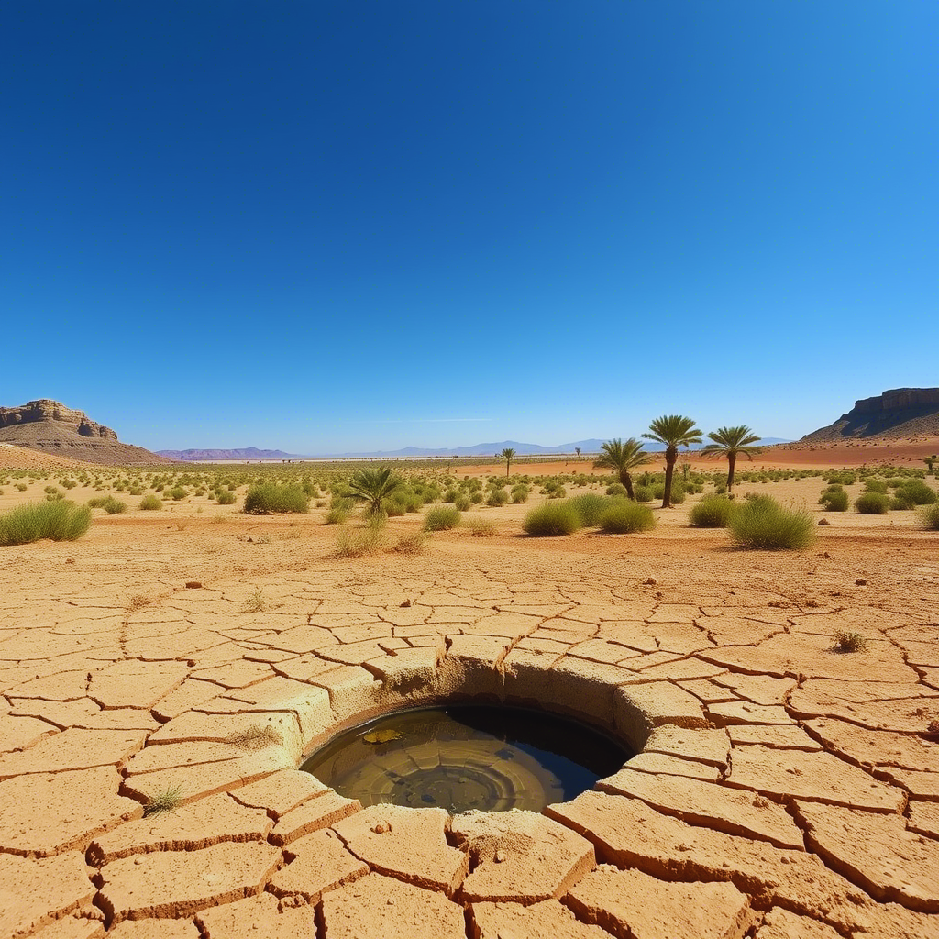

Extreme Water Poverty:
Jordan is one of the most water-scarce countries globally. It possesses far below the international water poverty line (e.g., less than 80 cubic meters per capita annually vs. 500 m³).
Escalating Demand:
Driven by rapid population growth, regional crises leading to refugee influxes, and expanding economic sectors like agriculture and industry.
Depleting Resources:
Over-reliance on non-renewable groundwater and highly variable surface water sources, leading to unsustainable exploitation.
Significant Water Losses:
High rates of Non-Revenue Water (NRW) from aging infrastructure and inefficient practices contribute to substantial water wastage.
Jordan's Water Scarcity
ESG Relevance:
A Critical Environmental & Social Challenge
This crisis severely impacts environmental sustainability, social well-being (food security, health), and requires robust governance for effective resource management.

Slide 3

AI-Powered Solutions for Sustainable Water Governance
Our Solution: AI for Smart Water Management
Data-Driven Decisions:
AI's Transformative Capabilities: Artificial Intelligence provides the tools to:
Our Project's Two Pillars: We apply Machine Learning to specifically address:
Achieving ESG Goals:
The water sector generates immense data (climate, consumption, infrastructure health, etc.). AI is crucial for processing this complexity and extracting actionable insights.
Predict Future Scenarios: Anticipate water deficits for proactive national planning and resource allocation.
Detect Inefficiencies & Waste: Identify anomalies like leaks in real-time and optimize water usage.
Support Informed Governance: Enable evidence-based policy-making for better water management.
Annual Water Deficit Prediction: To enhance strategic planning and contribute to Good Governance (G) in water resource management.
Smart Water Meter Leak Detection: To minimize immediate water loss, directly impacting Environmental (E) sustainability and resource efficiency.
By building intelligent systems for water management, our project aims to foster environmental protection, improve social well-being through water security, and strengthen governance frameworks.

Slide 4


Model 1: Forecasting Jordan's Annual Water Deficit
Purpose: This model aims to accurately predict the total water deficit for Jordan on an annual basis.
Strategic Importance:
Proactive Planning: Shifts from reactive crisis management to forward-looking resource allocation.
Informed Policy-Making: Provides essential data for government and water authorities to plan investments in new water sources (e.g., desalination, dams), adjust agricultural policies, or implement demand-management strategies.
Resource Allocation: Helps optimize the distribution of available water resources across different sectors (domestic, agriculture, industry).
Contribution to ESG:
Directly supports Good Governance (G) by enabling data-driven decision-making and contributes to Environmental (E) sustainability by forecasting resource needs.

Slide 5
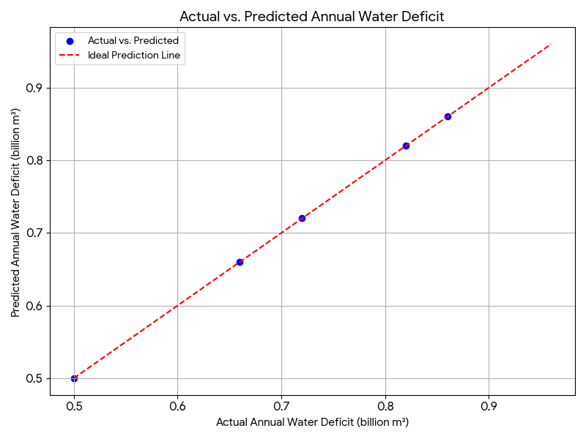
Model 1 in Detail: Methodology & Performance
How it Works (Methodology):
Data Inputs: We utilized historical data from 2000-2023, including: Water Productivity, Water Stress, Freshwater Withdrawal, Annual Rainfall, Groundwater Use, Non-Revenue Water, and other relevant water indicators. (You can list some of the main ones you just provided when asked about columns used).
Machine Learning Model: A Linear Regression model was employed, a fundamental yet powerful algorithm for predicting continuous values based on input features.
Training & Prediction: The model was trained on past data to learn the complex relationships between these variables and the Annual Water Deficit, enabling it to predict future deficit values.
Model Performance (Results):
Key Metrics:
R-squared (R2) Score: 1.0000 (100% Explanatory Power) - This indicates a perfect fit to the data, meaning the model accurately explains all the variance in the annual water deficit based on the input features.
Mean Absolute Error (MAE): 0.0000 - The average absolute difference between predicted and actual values is zero, showcasing exceptional precision.
Root Mean Squared Error (RMSE): 0.0000 - Also zero, reinforcing the model's high accuracy in predicting the deficit values.
Insight:
This model provides a highly reliable tool for long-term forecasting, crucial for Jordan's water security.

Slide 6
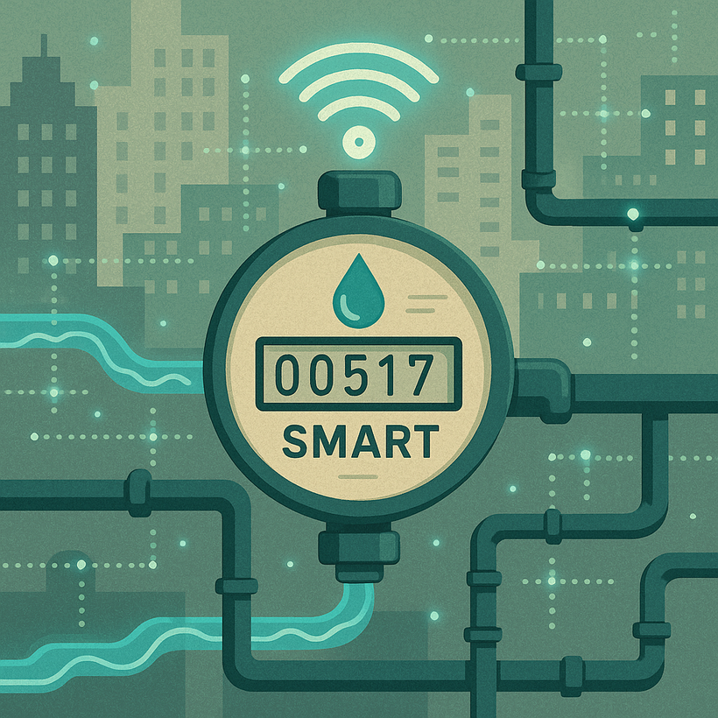
Model 2: Combating Water Waste with Smart Meter AI
The Problem of Water Loss:
Smart Meters as Data Sources:
AI's Role in Detection:
Contribution to ESG:
A significant portion of water is lost in distribution networks due to leaks, faulty infrastructure, and inefficient consumer usage. (You can re-emphasize the "Non-Revenue Water" percentage mentioned in your dataset here if you wish).
Modern smart water meters collect real-time, high-frequency data (e.g., hourly consumption), providing a rich source for anomaly detection.
Instead of relying on manual inspections or consumer reports, AI can analyze smart meter data to:
Identify unusual consumption patterns.
Pinpoint potential leaks quickly and accurately.
Reduce response times for repairs.
Directly addresses Environmental (E) sustainability by preventing resource wastage and contributes to Social (S) well-being by ensuring more equitable water distribution and reducing costs.

Slide 7
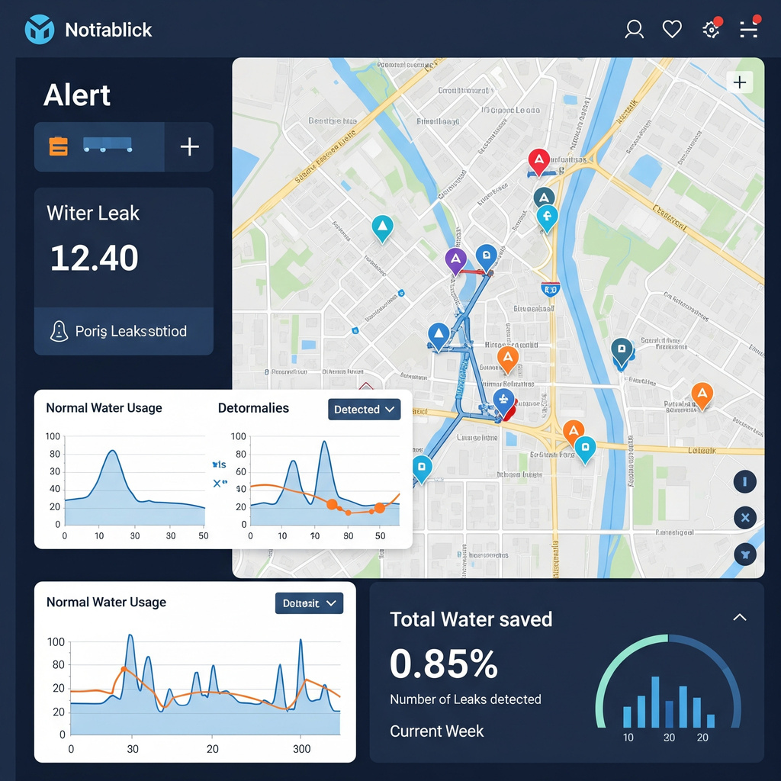
Smart Leak Detection: How It Works & Its Impact
How it Works (Methodology):
Continuous Data Monitoring: The system continuously collects and analyzes high-frequency water consumption data from smart meters (e.g., every 15 minutes or hourly).
Anomaly Detection AI: Machine Learning algorithms (e.g., clustering, statistical anomaly detection, or even simple rule-based systems trained on historical patterns) are trained to learn "normal" water consumption profiles for individual meters or network segments.
Identifying Deviations: The AI then flags any significant deviation from these learned normal patterns (e.g., continuous flow when a property should be idle, sudden spikes, or consistent high usage not matching historical trends).
Alert Generation: When an anomaly is detected, the system generates an immediate alert, potentially including the location and severity, for rapid intervention by water authorities.
Anticipated Impact (Conceptual Results):
Rapid Leak Identification: Shift from days/weeks to hours/minutes for leak detection.
Significant Water Loss Reduction: Expected reduction in Non-Revenue Water (NRW) by identifying leaks proactively. (You can quantify this with a potential percentage, e.g., "potentially reducing NRW by 10-15% in pilot areas").
Cost Savings: Lower operational costs for utilities (less water treated and pumped needlessly) and reduced water bills for consumers.
Enhanced Water Security: By conserving existing resources, the system directly contributes to better resource management and overall water sustainability.

Slide 8

A Holistic Approach: Integrating AI for Water Security
Model 1 (Annual Deficit Prediction):
Synergy of Models
Model 2 (Smart Meter Leak Detection):
Provides the strategic foresight. It gives authorities the necessary lead time to plan large-scale interventions, secure funding, and develop macro-level policies for the coming year's water needs. It answers: "What's our big water challenge coming up?"
Offers operational efficiency and immediate impact. It identifies and minimizes daily water losses, optimizing the existing infrastructure and conserving precious resources in real-time. It answers: "How do we stop wasting water right now?"
Comprehensive Water Management:
Reinforcing ESG Goals:
Addresses both long-term scarcity (strategic) and short-term waste (operational).
Enables proactive and reactive measures.
Maximizes the utility of available water resources.
Environmental (E): Reduces water loss, conserves natural resources.
Social (S): Improves water access, ensures equitable distribution, supports public health.
Governance (G): Empowers data-driven policy-making, enhances transparency and accountability in water management.

Slide 9

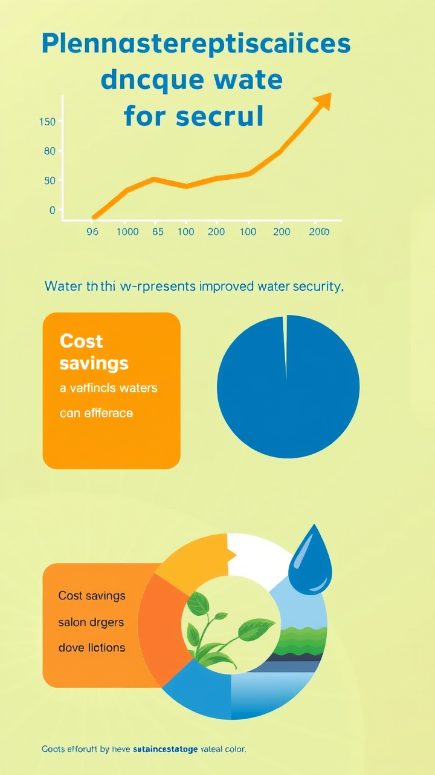
Projected Impact & Future Development:
Quantifiable Impact (Conceptual, but based on potential):
Improved Water Security: By X% (e.g., "15%") through better resource allocation and reduced waste.
Cost Savings: Reduced operational costs for water utilities by Y% (e.g., "10%") and lower water bills for consumers.
Enhanced Sustainability: Reduced strain on water sources, contributing to long-term ecological balance.
Future Development:
Integration with broader city infrastructure: Connecting the AI system to other smart city initiatives (e.g., energy, transportation).
Expanding the AI models: Incorporating more data sources (e.g., weather patterns, soil moisture) to improve prediction accuracy and leak detection.
Developing a user-friendly platform: Creating an intuitive interface for water authorities and citizens to access real-time data and insights.
Predictive Maintenance: Using AI to predict potential infrastructure failures (e.g., pipe bursts) before they occur.

Slide 10



Questions & Discussion
Thank you for your time and attention.
We welcome your questions and feedback.
Let's work together for a water-secure future.
Get In Touch
+962775575322
holimat6@gmail.com

